Slide 1
Challenge and Retention in Games
Thomas Debeauvais
Advisor: Crista Lopes

Slide 2
Outline
Motivation and Thesis
Data and Methodology
Findings
Lessons Learned

Slide 3
Motivation and thesis
Retention
Challenge
Thesis
Research Questions

Slide 4

Retention in Games
Introduction
Start Playing
Pastime
Loyalty
Word-of-mouth
Advertisement Requirement
Notes:
Download/install

Slide 5



Retention in Games
Introduction
Start Playing
Pastime
Loyalty
Word-of-mouth
Advertisement Requirement
Keep Playing
(Retention)
Enjoyment/Fun
Peer pressure
Notes:
Add arrow

Slide 6

Retention in Games
Introduction
Start Playing
Pastime
Loyalty
Word-of-mouth
Advertisement
Requirement
Keep Playing
(Retention)
Enjoyment/Fun
Peer pressure
Drop out
(Churn)
Notes:
Add arrow

Slide 7
Retention is Important
Introduction
Bottom-line for game companies
Games in Education
Game-based Rehabilitation

Slide 8
Retention in the Literature
Introduction
Theoretical studies
Continuation desire [Brown09] [Schoenau11]
Time spent playing [Boyle12]
Loyalty, replay, recommendation [Hamari15]
Studies using commercial game data
Aion [Nozhnin12]
Diamond Dash [Runge14]
Notes:
What we know about retention
Engagement
Predict churn – rare because data usually secret

Slide 9



Affecting Retention in Games
Introduction
Challenge
Game mechanics
Community
Business model
Notes:
Knobs at the disposal of game companies

Slide 10
Affecting Retention in Games
Introduction
Challenge
Game mechanics
Community
Business model
Notes:
This work focuses on challenge

Slide 11
General line of inquiry
Introduction
How does challenge
affect retention?
Notes:
Maybe some industry ppl know this already, but it’s not out in the open

Slide 12
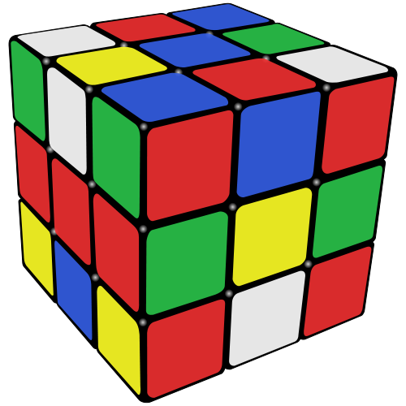
Challenge
Introduction
Effort to reach goal [Karhulahti13]
[Malone80] includes:
Difficulty
Randomness
Notes:
We know lots about challenge

Slide 13
Challenge is Important in Games
Introduction
Motivation to play
[Malone80] [Jansz07] [Hainey10]
Found across player typologies
[Bartle96] [Bateman07] [Drachen13]
Central aspect of game design
[Adams06] [Koster13] [Juul13]
Notes:
Challenge is the elephant in the room when talking about fun and why people play games

Slide 14
Challenge – Retention
Introduction
Academia with game data
Detect frustration [Drachen09] [Canossa11]
Adapt difficulty to reduce churn [Harrison13]
Industry reflections
Lack of new patterns causes churn [Koster13]
Similarities between Starcraft 2 and WoW [Pardo08]
Ad-hoc
Game-specific
Little is known
Notes:
Little generalizable,
empirical knowledge
about retention in games

Slide 15
Thesis
Introduction
Challenge influences retention,
but this influence is highly contextual.

Slide 16
Research Questions
Introduction
Q1) Is difficulty correlated with churn?
What other factors influence retention?
Q2) Does time have an effect on retention?
Q3) Which player segments tolerate challenge most/least?
Q4) Do other players affect retention?
Notes:
While exploring the main question, several others popped up

Slide 17
Data AND METHODOLOGY
Notes:
To answer my research questions

Slide 18
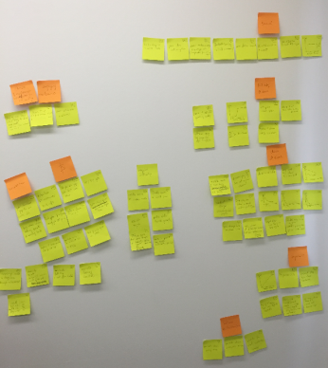
Methodology
Data and Methodology
Acquire data
Play the games: identify challenge
Formulate concrete questions
Look at data
Identify challenge metrics
Define retention metrics
Correlate challenge and retention
Pay attention to possible confounding factors
Pursue further analysis with those factors
Build affinity diagram from findings
iterate
Notes:
My process

Slide 19




Data
Data and Methodology
Game | Method
Ragnarok Online | 9 semi-structured interviews 30+ participant observation
World of Warcraft | 2865 questionnaire participants 1350 questionnaire + in-game data for 7 months
Forza Motorsport 4 | 220,000 player data from telemetry for 2 years
Jelly Splash | 274,000 player data from telemetry for 10 weeks
Undisclosed game | 78,000 player data from telemetry for 3 months
U
Notes:
I used different methods to look at all these games

Slide 20
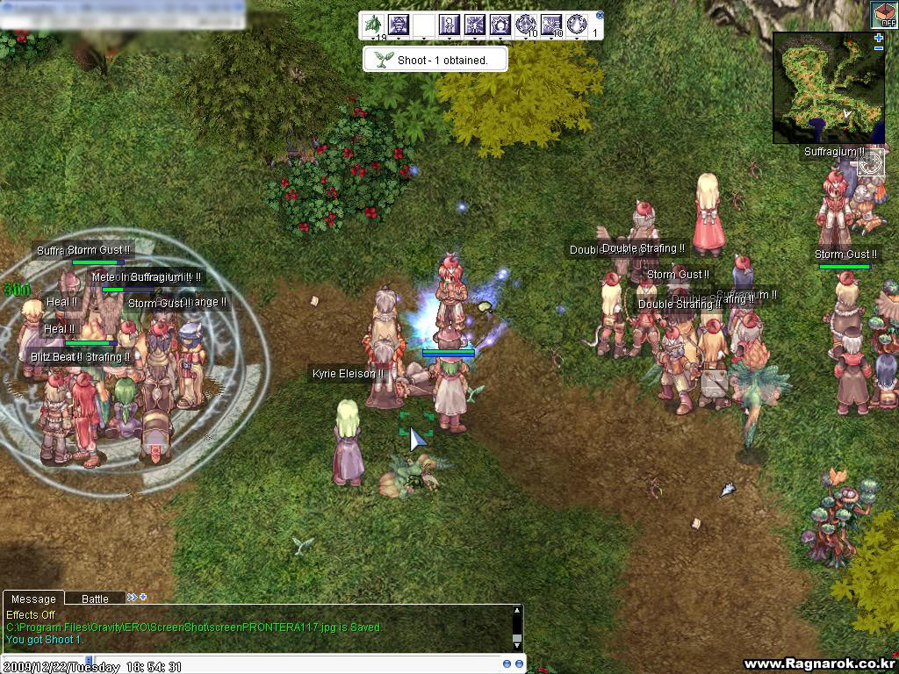

Data and Methodology
Notes:
2002, lots of grind, hence bots
Interesting for my work because private servers
Finding gear - Higher drop rates
Long leveling - Higher XP rates
Difficult monsters - Increase group XP and size

Slide 21
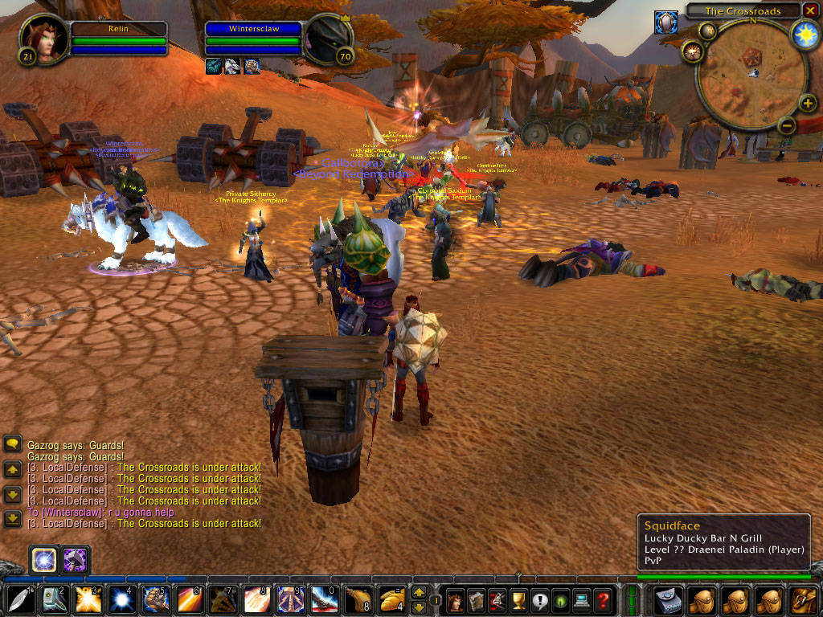

Data and Methodology
Notes:
10M+ players, “opened MMO to the masses” -> lots of demographic segments.
Amassing gold - Buy gold from third party
Dungeon bosses – reduce difficulty by 5% per month

Slide 22
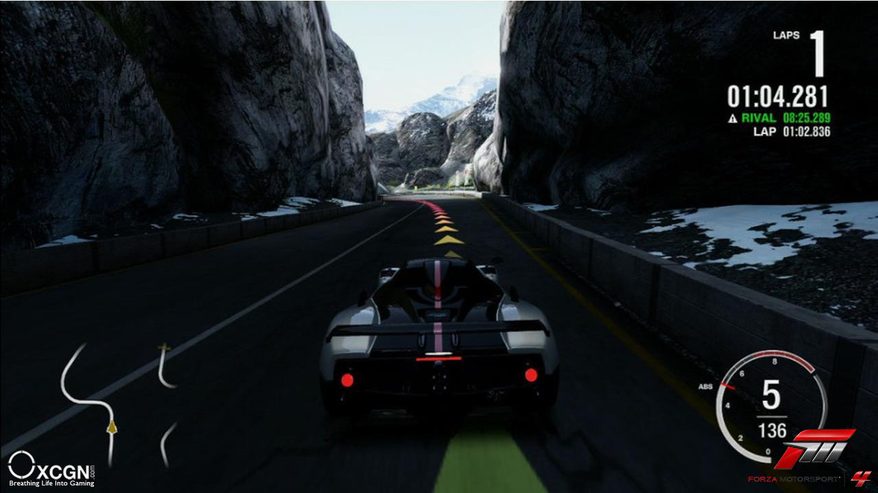
Data and Methodology
Notes:
5M copies sold, assists allow players to configure the difficulty themselves
Assists: turn properly, don’t take damage, handle gear box

Slide 23
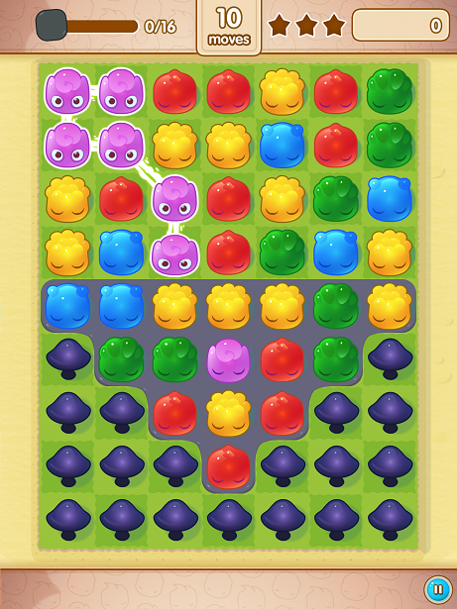
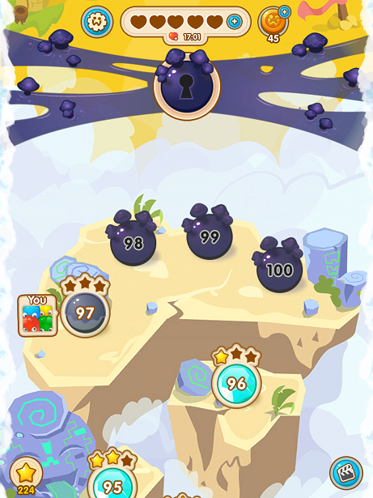
Data and Methodology
Notes:
8 million monthly active players in December 2013
Each level has a goal, limited moves
Winning a level - Buy extra moves
Passing a gate - Invite friends or pay

Slide 24
Data and Methodology
U
Notes:
Soft-launched summer 2015. Millions of players.
Passing levels – buy a continue

Slide 25
Challenge in the 5 games
Data and Methodology
Game | Challenge | Challenge metrics | Retention metrics
 | Finding gear Difficult monsters | Player reports | Player reports
 | Amassing gold Dungeon bosses | Bosses killed PvP occurrences | NA
 | Turning properly Not taking damage | Disabling an assist | NA
 | Winning a level Passing a gate | Level difficulty | Churn
 | Winning a level | Level difficulty | Churn
U

Slide 26
Q1) Is difficulty correlated with churn?
Jelly Splash
Undisclosed game
Ragnarok Online
Notes:
3 games for which we have metrics for both challenge and retention

Slide 27
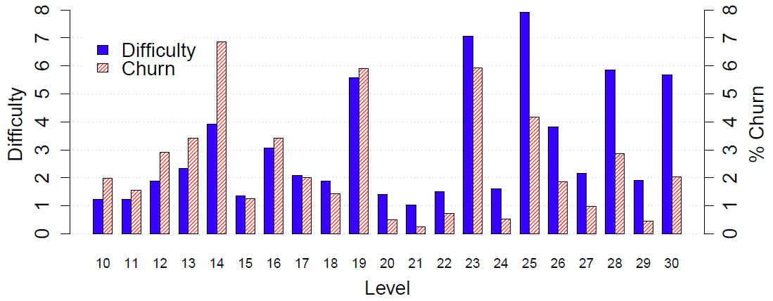
Difficulty correlates with Churn
Q1) Is difficulty correlated with churn?
- Overall difficulty increases with level: spearman rho(138) = .41, p<.001
- Partial correlation of difficulty with churn, controlling for level number: rho(138) = .71, p<.001
Notes:
Difficulty causes churn: Spikes coincide
pcor between diff and churn: spearman ro = .71

Slide 28
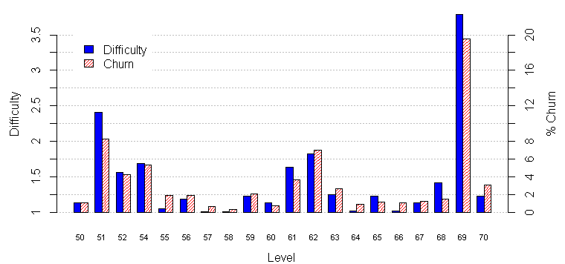
Difficulty correlates with Churn
Q1) Is difficulty correlated with churn?
U
- Overall difficulty increases with level: spearman rho(99) = .21, p=.04
- Partial correlation of difficulty with churn, controlling for level number: rho(99) = .66, p<.001
Notes:
Difficulty causes churn: Spikes coincide

Slide 29
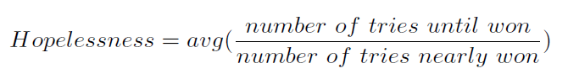
Perception of Difficulty
Q1) Is difficulty correlated with churn?
Level Hopelessness - inspired by [Steinhoff15]
“Nearly won” = complete more than 75% of objective
Hopelessness correlates with churn
Spearman rho=.13, p<.05
Controlling for difficulty
Controlling for level number
Notes:
Not only difficulty, but also players’ perception of difficulty, influence churn

Slide 30
Perception of Difficulty
Q1) Is difficulty correlated with churn?
U
Level Hopelessness
“Nearly won” = completing all but the last wave
Hopelessness correlates with churn
Spearman rho(99) = .40, p<.001
Controlling for difficulty
Controlling for level number

Slide 31

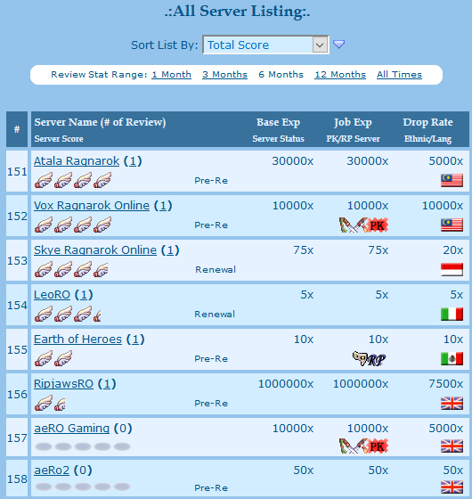
Rates
Q1) Is difficulty correlated with churn?
Players who prefer playing on private servers do it because:
Easier to obtain equipment
Easier to level-up
Notes:
Talk about what is a rate
Players go on pservs because they reduce difficulty
Also related to perception of difficulty (but not churn): F4 players disable assists more permanently when followed by easier race

Slide 32
Summary
Q1) Is difficulty correlated with churn?
Implications for design
Data indicate that making the game easier may retain more players in the long run
Positioning with the literature
Confirms previous work [Canossa11]
But also contradicts others [Juul13]

Slide 33
Q2) Does time have an effect on retention?
Jelly Splash
Undisclosed game
Forza 4
World of Warcraft
Notes:
While studying difficulty, I found these other possible confounding factors
Natural effect of time
Jelly Splash, Forza 4, WoW, Undisclosed game

Slide 34
Likelihood to churn this session
Q2) Does time have an effect on retention?
Session variable (p<.001) | Log Odds Ratio
Session number | -.02
Days since install | .05
Level reached at session end | -.05
Levels gained during session | .04
*Lives at session start | .21
*Lives at session end | .15
Ratio of wins during session | -.21
Difficulty of level reached at session end | .07
*Level reached at session end is a gate | .70
p>.1 for: session duration, games played during session, level hopelessness
Notes:
Label is “is this session my last?”
* Denotes game-specific features (gate, lives)
For 2 players at the same level, the log odds of churning for the one who has been playing one day longer are 5% higher

Slide 35
Likelihood to churn this session
Q2) Does time have an effect on retention?
U
Session variable (p<.001) | Log Odds Ratio
Session number | -.02
Days since install | .02
Level reached at session end | -.09
Levels gained during session | .11
+Session duration (minutes) | .00
+Games played during session | -.05
Ratio of wins during session | -.55
Difficulty of level reached at session end | .20
p>.1 for: level hopelessness
Notes:
Label is “is this session my last?”
+ denotes features that were not significant in JS model
For 2 players at the same level, the log odds of churning for the one who has been playing one day longer are 2% higher

Slide 36
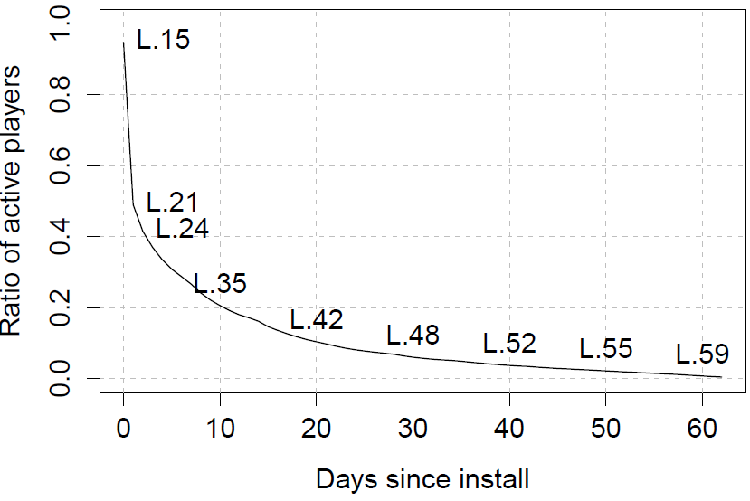
Active Population Over Time
Q2) Does time have an effect on retention?

Slide 37
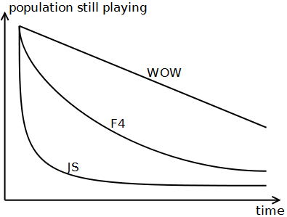
Shape of Time Effect Varies
Q2) Does time have an effect on retention?
Notes:
These games have different business models: subscription vs paid box vs f2p

Slide 38
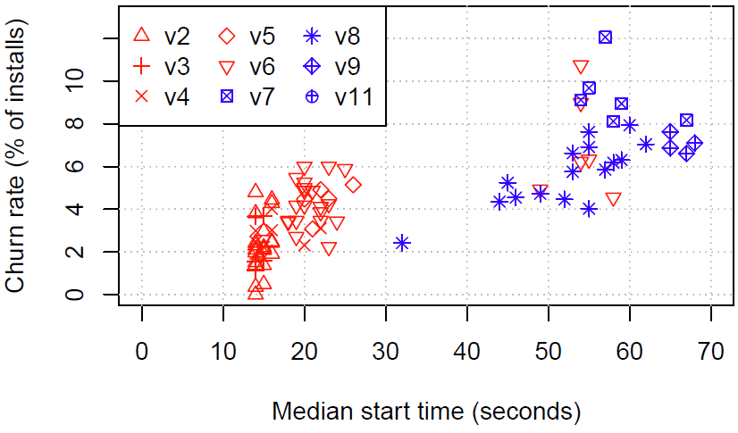
Loading Time
Q2) Does time have an effect on retention?
U
Notes:
Loading time

Slide 39
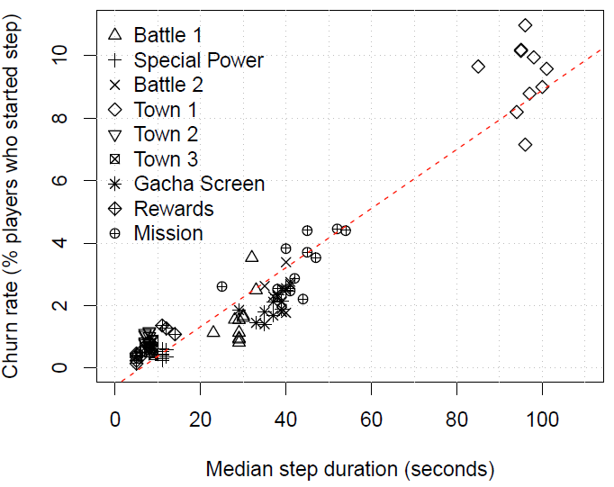
Step Duration
Q2) Does time have an effect on retention?
U
R2=.90,
p<.001,
beta=.10
Notes:
Each dot represents 1 step for 1 version
R2: Time explains 90%+ of churn rate
Beta: for every 10 seconds spent in a step, 1% of players churn
Take-away: Churn does not change across steps, but depends on time only

Slide 40
Summary
Q2) Does time have an effect on retention?
Implications for design
Players will drop out – the question is how fast
Players are impatient
Positioning with the literature
Players acquire skills over time [Koster13] [Gee05]
In certain games, time is a measure of difficulty [Juul10]
First 15 minutes should be rewarding [Meier10]
Notes:
When making a tutorial, make it interesting, and make it short if it has lots of unskippable hand-holding

Slide 41
Q3) Which player segments tolerate challenge most/least?
World of Warcraft

Slide 42
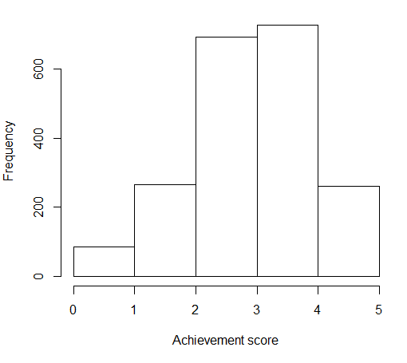
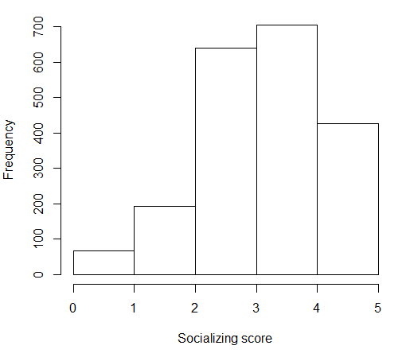
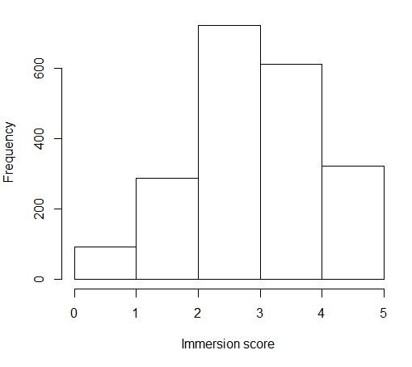
Tolerance to Difficulty
Q3) Which player segments tolerate difficulty most/least?
Notes:
5 questions related to achievement, each a 5-point likert scale
Eg “I like leveling up” or “killing other players is fun”
ach score = average of 5 questions

Slide 43
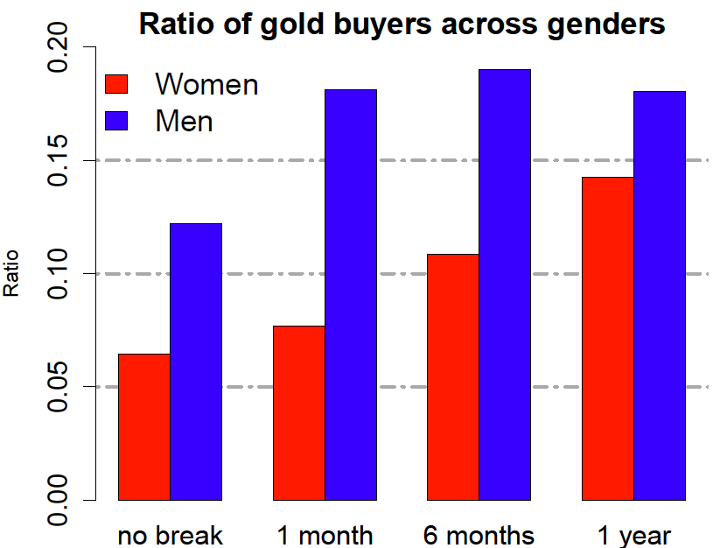
Q3) Which player segments tolerate difficulty most/least?
Notes:
Buying gold = tolerating difficulty least

Slide 44


Region and Gender
Q3) Which player segments tolerate difficulty most/least?
 | Women | Men | Women | Men
N | 84 | 469 | 313 | 484
Raids in 7 months | 29 | 26 | 24 | 20
PvP in 7 months | 13 | 15 | 4 | 5

Slide 45
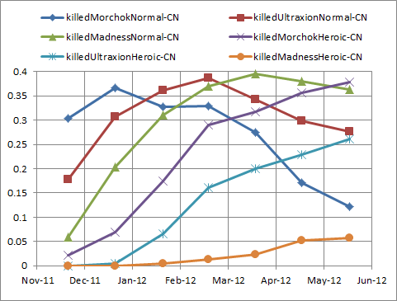
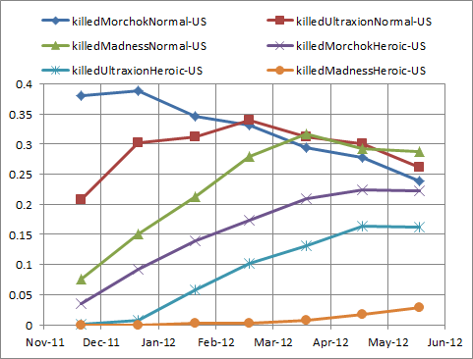
Region
Q3) Which player segments tolerate difficulty most/least?
Notes:
CN tackle harder bosses than US

Slide 46
Summary
Q3) Which player segments tolerate difficulty most/least?
Implications for design
Need to know players to target them better
Release different versions in different regions?
Not feasible for e-sports
Positioning with the literature
Women play more, are happier if playing with partner, and under-estimate weekly play time more than men [Williams09]
Elderly prefer casual puzzles, play to pass time [Pearce08][DeSchutter11]

Slide 47
Q4) Do other players affect retention or enjoyment?
World of Warcraft
Ragnarok Online
Forza 4

Slide 48
Guilds
Q4) Do other players affect retention?
 | Not in a guild | Guild member | Guild officer/leader
N | 277 | 1569 | 1006
Weekly play time | 19 | 22 | 24
Stop rate | 88% | 79% | 71%
Notes:
Main social structure in WOW
Positive influence: being in a guild

Slide 49

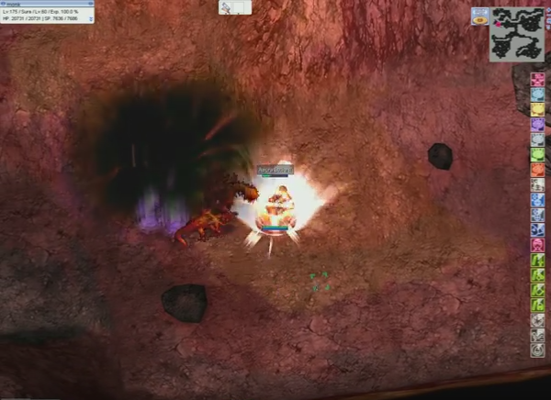

Solo Monks
Q4) Do other players affect retention?
Notes:
Negative influence on ret: solo monks
Monks can solo boss monsters thanks to the Healer and Warpra NPC
Players report switching servers when their server has too many solo monks and they can’t find boss monsters

Slide 50
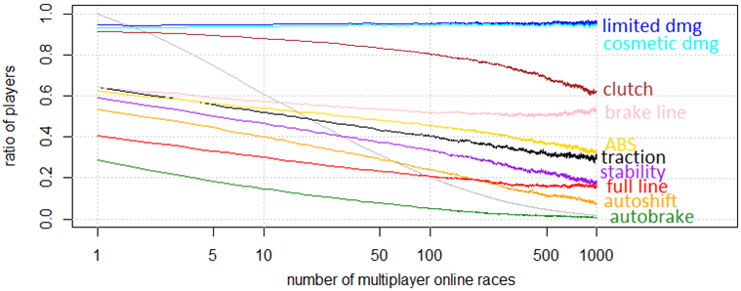
Disabling Damage
Q4) Do other players affect retention?
Notes:
Dmg always enabled – hell is other players (Online mode races)
Not immediately related to retention, but definitely to enjoyment

Slide 51
Summary
Q4) Do other players affect retention?
Implications for design
Playing with others can be a double-edged sword
Positioning with the literature
Other players help learn about the game [Nardi06]
Influence of social network on retention and purchases [Williams14]
Misogynistic gamer culture [Consalvo12]

Slide 52
Lessons learned

Slide 53
Thesis
Lessons Learned
Challenge influences retention,
but this influence is highly contextual.

Slide 54
Research Questions
Lessons Learned
Q1) Is difficulty correlated with churn? Yes
What other factors influence retention? Many
Q2) Does time have an effect on retention? Yes
Q3) Which player segments tolerate challenge most/least? It depends
Q4) Do other players affect retention? Sometimes
Notes:
While exploring the main question, several others popped up

Slide 55

Affinity Diagram
Lessons Learned
Retention metrics: Q8
Adaptive
difficulty: Q6
Social: Q4
Difficulty: Q1
Engaging mechanics
Spending money
to again an
advantage: Q5
Time: Q2
Segments: Q3
Learning incentives
Hardware: Q87
Notes:
This diagram helped answer the RQ
But also indicates more directions, e.g. money

Slide 56

Q5-Spending money to gain an advantage
Lessons Learned
Paypal equipment in elitist guilds
Purchases happen mostly at:
Difficult levels
Gates
Money also influences retention

Slide 57
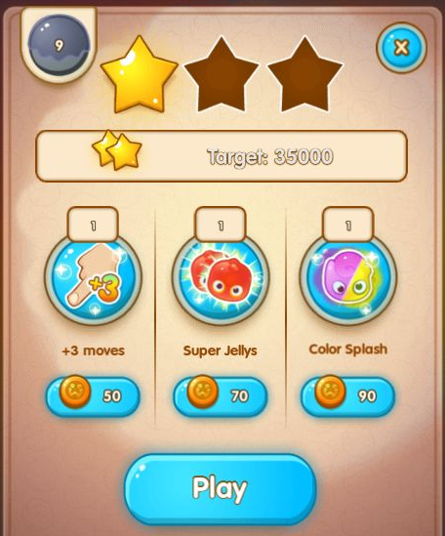

Retention vs Monetization trade-off
Lessons Learned
Notes:
F2p biz model: Sell functional or aesthetic items (power-ups vs skins)
Functional rely on difficulty to sell, but difficulty causes churn
-> what about aesthetic items?

Slide 58
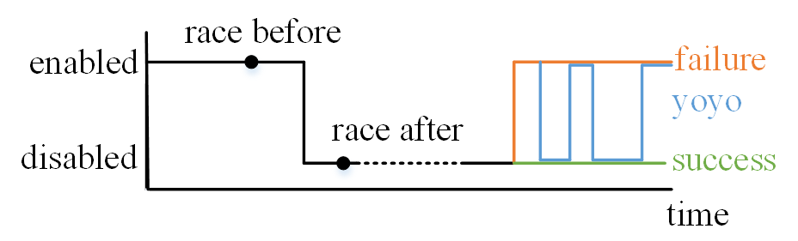
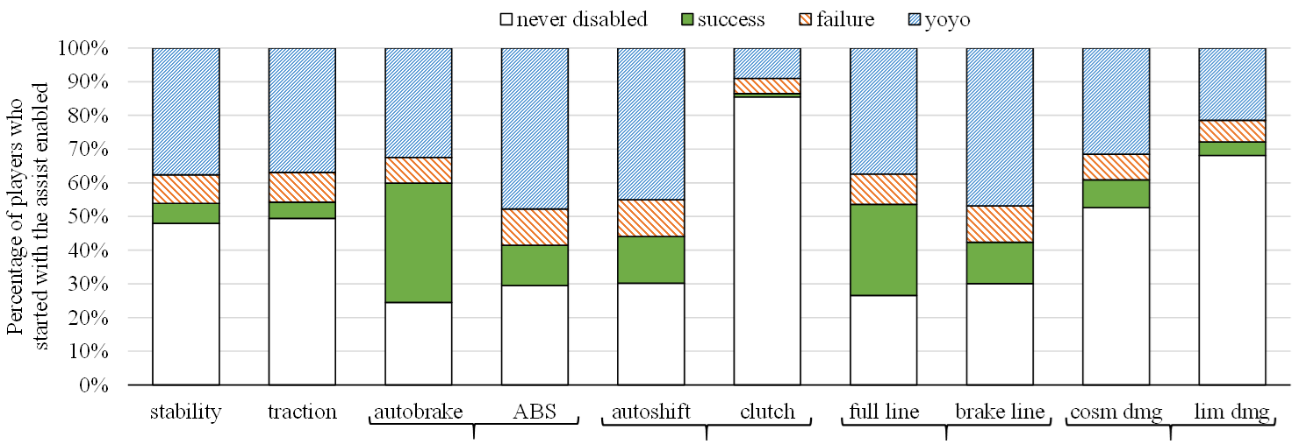
Q6 - Adaptive Difficulty
Lessons Learned
Notes:
Gist: given the appropriate mechanics, players will configure the difficulty according to their taste and capacity
Easy assists (full line, autobrake) vs hard assists (clutch)
Player skill = white vs green vs red vs blue

Slide 59
Q7 – Hardware
Lessons Learned
iPhone vs iPad
Android devices are very diverse
Pre-tutorial churn comes mostly from:
Low-end devices
TVs trying to run the game
U

Slide 60
Q8 – Retention metrics
Lessons Learned
Intensity
Weekly play time, number of sessions per day
Longevity
Taking breaks, churning
Satisfaction/recommending to a friend
Purchasing

Slide 61
Contributions
Lessons Learned
The first systematic, cross-game study of the influence of challenge on retention
Showing that in two level-based games, difficulty and churn are positively correlated
The first study showing preliminary evidence of the natural effect of time on churn
The first study providing objective metrics quantifying challenge
Additional evidence for:
The impact of social interactions on retention
The influence of money on retention
Players changing the difficulty themselves
The diversity of players’ tastes and tolerance to difficulty

Slide 62
Thank you

Slide 63
What is “Fun”?
Background
Challenge [Sweetser05]
Fantasy [Malone80]
Aesthetics [Mekler14]
Presence/immersion [Yee07]
Socializing [Nardi06]
Notes:
There are many reasons why people play games. Challenge is not the only one, but
it’s in all games,
The literature agrees that it’s central to play,
it’s somewhat measurable.

Slide 64
Findings – Ragnarok Online
Findings - RO

Slide 65
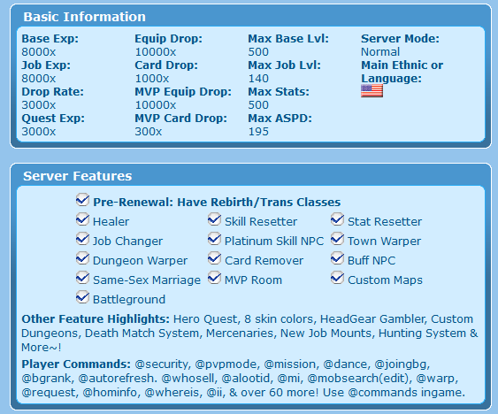
Private Servers
Findings - RO
Notes:
Hundreds of pservs
Higher Rates, extra features

Slide 66

Research Question & Methods
Findings - RO
Why play on a private server?
Participant observation
9 semi-structured interviews
Read forums
Play the game
Official server and 2 private servers
November 2009

Slide 67
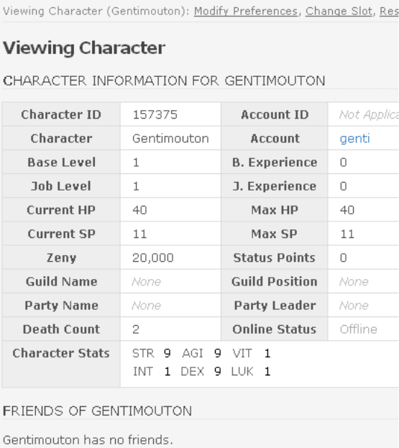
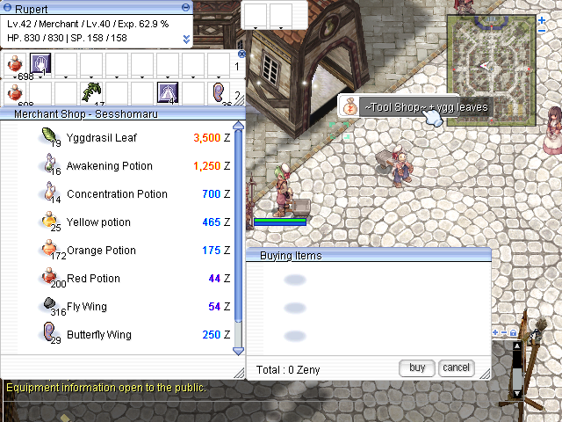
Findings
Findings - RO
Notes:
Players prefer pservs because:
1- they support group play: buff group XP, @who, low pop fixed Warpra and Healer which enable solo play
2- they boost economy (which reduces the game’s difficulty): increased rates (reduce grind), @autotrade, @whosell
3- quality of life: Control panel to show off, bot hunting, but f2p vs p2win paypal donations

Slide 68
Findings – World of Warcraft
Findings - WOW

Slide 69
Research Question & Methods
Lessons Learned
Do different demographic segments play and churn differently?
Online survey of 2865 players in Spring 2010
Gender, age, country, big 5
Play motivations: achiev., immersion, social [Yee06]
Years played, weekly play time, took breaks
Play with real-life vs virtual friends
And more …

Slide 70
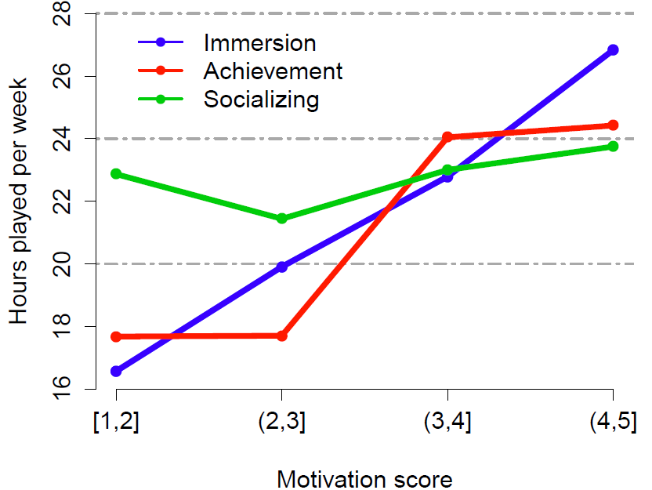
Findings
Findings - WOW

Slide 71
Research Question & Methods
Findings - WOW
Which segments of players buy gold most?
Same online survey data

Slide 72
Findings
Findings - WOW

Slide 73
Research Question & Methods
Findings - WOW
How fast do players consume new content?
Online survey in November 2011
Same questions as before
1350 respondents, 41% Chinese
Daily pull of game data until June 2012
Dungeons entered, PvP occurrences, char. played
Notes:
Patch 4.3 launched on Nov 30 2011

Slide 74
Findings
Findings - WOW

Slide 75
Summary
Findings - WOW
Segments: regions, gender
Achiev. and immersion increase play time
Socializing does not
But guild position does
Active player raiding activity decreases over time
Notes:
Men more motivated by ach, women by social

Slide 76
Findings – Forza 4
Findings – F4

Slide 77
Research Question & Methods
Findings – F4
Do players change the difficulty themselves?
Telemetry data from 220,000 players
25M race entries
October 2011 – July 2013

Slide 78
Findings – F4
 | Easy | Medium | Hard | Advanced | Expert
Line | Full |  | Brake |  | OFF
Stability | ON |  | OFF
Traction | ON |  |  | OFF
Braking | Assisted w/ ABS |  | ABS | OFF
Gear Shifting | Automatic w/o clutch |  |  | Manual w/o clutch | Manual w/ clutch
Damage | Cosmetic | Limited |  | Simulation

Slide 79
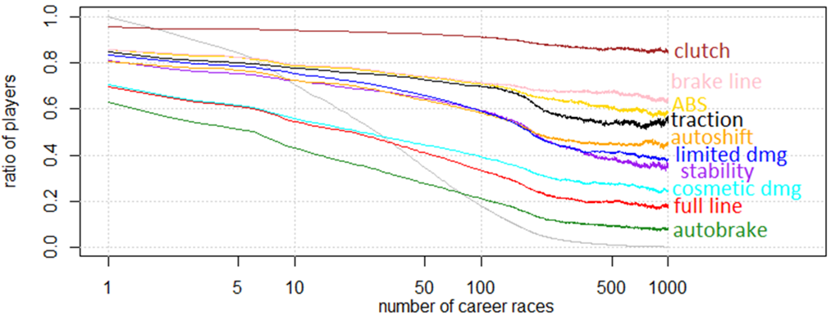
Findings
Findings – F4

Slide 80
Findings
Findings – F4
Notes:
Dmg always enabled – hell is other players (Online mode races)

Slide 81
Findings
Findings – F4
Notes:
Easy assists (full line, autobrake) vs hard assists (clutch)
Player skill = white vs green vs red vs blue

Slide 82
Forza 4 – logistic regression
Findings – F4
 | Log OR | Explanation
Position at finish line | + | Confidence?
Car performance index | – | “Stacking handicaps” Sedan first, F1 right after
Number of races | – | Habit?
Notes:
Predict whether assist will be disabled permanently on the race before it is disabled

Slide 83
Forza 4 – log reg performance
Findings – F4
 | Precision | Recall
Autobrake | 84% | 97%
Full line | 78% | 95%
Clutch | - | -
Others | 60-70% | 50-80%
Notes:
Predict whether assist will be disabled permanently on the race before it is disabled

Slide 84
Summary
Findings – F4
Given the opportunity, players tune the difficulty themselves
Easier assists are disabled faster
Easier assists are disabled more permanently
Other players can get in the way
Notes:
Men more motivated by ach, women by social

Slide 85
Findings – jelly splash
Findings – JS

Slide 86
Research Question & Methods
Findings – JS
What is the impact of difficulty on churn?
Telemetry data from 273,000 players
25M games
37,000 purchases

Slide 87
Findings
Findings – JS
Notes:
Difficulty causes churn: Spikes coincide
pcor between diff and churn: spearman ro = .71
Also, hopelessness = players’ perception of difficulty, causes even more churn

Slide 88
Summary
Findings – JS
Difficulty causes churn
But also purchases
Churn decreases with level number
Players churn early or later/never

Slide 89
Findings – undisclosed game
Findings – U
U
Notes:
Skip if not enough time

Slide 90
Research Question & Methods
Findings – U
U
What is the impact of the tutorial on churn?
Telemetry data from 78,000 players
2M logins and 4M tutorial steps recorded

Slide 91
Findings – Loading Time
Findings – U
U
Notes:
Loading time

Slide 92
Findings – Step Duration
Findings – U
U
Notes:
Each dot represents 1 step for 1 version
Time explains 80%+ of churn rate
Churn does not change across steps

Slide 93
Summary
Findings – U
U
Tutorial churn comes from:
Mostly time
Not particular mechanics
Longer loading time
Improper devices

Slide 94
Factors influencing retention
Approach
Game | Challenge | Time | Social | Money | Misc.
 | Higher rates Stronger economy | Higher rates | Group play | Paypal gear | Anti-bot system
 | Buying gold Dungeon bosses | Content consumption | RL vs IG ties | Buying gold | Gender, region
 | Assists & bundles Mode | Disabling assists | Damage assist |  | Veterans
 | Level difficulty Hopelessness Replays | Churn early or never | FB logins | Gates Extra moves
 |  | Loading time Step time | New PVP feature |  | Unsuitable devices
U

Slide 95

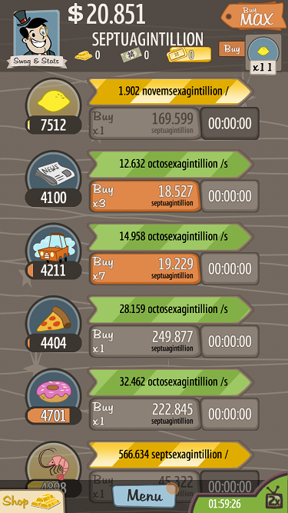
Introduction
Notes:
The “effort” differs between games.
Skill = planning, reaction (FPS), or dedication
Adventure capitalist, Flappy bird

Slide 96

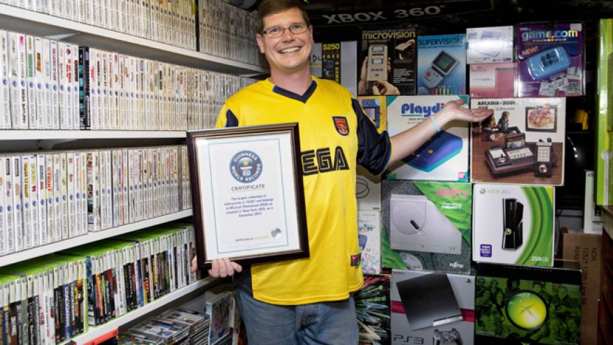


Introduction
Photos by Ralph Orlowski, Guiness Book Record, Getty Images, and Telegraph.co.uk
Notes:
“Challenging” differs between players.

Slide 97

Background
Bored
Anxious
Engaged
Notes:
Same game, different player reactions

Slide 98

Lessons Learned
Time
Player skill
Player motivations
Hardware
Money
Friends, family
Immersion
Competition
Socializing
…

